Slide 1
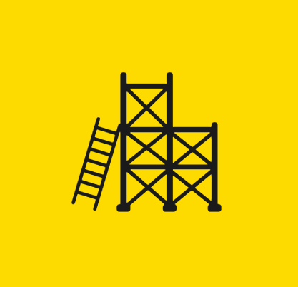
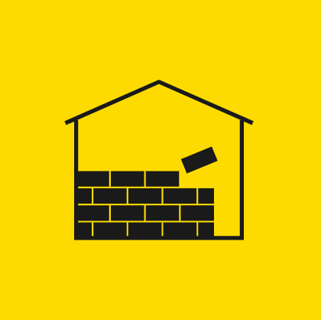
A Snapshot: Falls From Height Data Analysis
Falls from heights continue to be a major cause of injury and death in Ontario workplaces.
What are the root causes of falls from heights?
To answer this question, the ministry analyzed the prosecution files which are prepared by ministry inspectors about fatal injuries, a data source which has not been explored before.
The analysis covered a total of 92 fatal falls from a height that occurred between 2009 and 2016. The analysis found that 29 workers had died in their first year on the job. 14 were killed on their first month on the job.
92
60
29%
65+
35
Analysis covered 92 fatalities due to falls from a height
Construction Program: 60
Industrial: 31 Other:1
Self-Employed or Owner: 29%
Hired: 71%
9 fatalities among workers older than 65
38% of fatal accidents happened in the summer
21
52
45
29
14
Roofing contractors: 21 Residential construction workers:13
Small worksite with less than 4 workers on site: 52 (63%)
Company Size:
1-5: 45
6-19: 20
29 (45%) workers had less than 1 year experience in the role
14 workers with fatal injuries in their first month in role

Slide 2
Time in Role
Number of Years (n=64)
Less than a year in role
Cumulative Count
Some form of falls prevention training
1
day
1
week
1
mnth
3 mnth
6 mnth
1
year
3
7
14
19
25
29
*Training information was available for 66 of the 92 analyzed fatalities.
Number of Workers on the
Worksite (n=82)
Factor Analysis
by MOL Program (Each fatality with 1+ factors)
What went wrong despite training?
Factors Present When Falls Training is Evident
14
23
63%
15
5
6
+
19

Slide 3
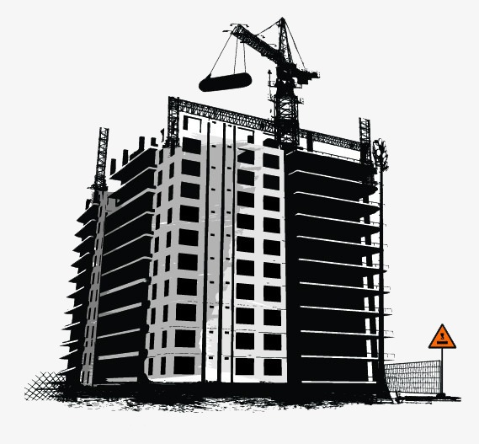
ADDITIONAL INSIGHTS
The three most common contributing factors to falls were lack of worksite instruction, not wearing personal protection equipment (PPE) and lack of falls training.
Roofing contractors and residential building construction were the sectors with the most number of fatalities. They had large than average instances of lack of worksite instruction and wearing PPE improperly.
Among the 60 construction fatalities analyzed, 32 workers had fall prevention training (53%), 20 didn’t receive training (33%), training information was not available in 8 of the analyzed construction fatalities (13%). Among 32 construction fatalities where training was evident, the most common factors were wearing PPE improperly, lack of worksite instruction and not wearing PPE.
Small businesses featured a larger proportion of the following factors: pushed or struck by object, unsafe scaffold, unsafe ladder, unsafe behavior/misjudgment, lack of falls training and not wearing PPE.
Fatalities peak in August, but are generally more frequent from June through December.
Fatalities peak at 11 am and 2 pm and plummet at 12 pm. Fatalities steadily decline after 2 pm.
Fatalities by age are distributed in a bell curve with nearly equal occurrence in the 15-24 and 65+ age groups.
The 55-64 and 65+ age groups had a larger than average number of fatalities due to not wearing PPE.
22-75 m | 9 fatalities
… … …
19-21 m | 2
16-18 m | 1
13-15 m | 2
10-12 m | 6
7-9 m | 12
4-6 m | 31
1-3 m | 26
Height of Fall
*Height of fall information was available in 89 of the 92 analyzed fatalities.
 | Height (m)
Worker Location | 1 | 2 | 3 | 4 | 5 | 6 | 7 | 8 | 9 | 10-19 | 20+ | Total
Roof |  |  | 4 | 3 | 2 | 9 | 2 | 3 | 1 | 4 |  | 28
Ladder | 1 | 7 | 1 | 1 | 4 | 3 | 1 |  | 1 |  | 2 | 21
Scaffold |  | 1 | 3 | 1 |  | 2 |  |  |  | 1 |  | 8
Suspended Platform |  |  |  |  |  |  |  |  |  | 1 | 6 | 7
Floor |  |  | 4 | 1 |  |  |  |  |  | 1 |  | 6
Moving Equipment | 1 |  | 2 |  |  | 1 |  |  | 1 |  |  | 5
Other |  |  |  | 1 |  | 1 |  | 1 |  |  | 1 | 4
Tree |  |  |  |  |  |  |  | 1 | 1 | 1 |  | 3
Road/Ramp/Dock | 1 |  |  |  | 1 |  |  |  |  |  | 1 | 3
Balcony |  |  |  |  |  |  |  |  |  | 1 | 1 | 2
Platform |  | 1 |  | 1 |  |  |  |  |  |  |  | 2
Total | 3 | 9 | 14 | 8 | 7 | 16 | 3 | 5 | 4 | 9 | 11 | 89

